Slide 1
















Entity Linkage in Evolving Temporal Graphs
Data Intensive Systems - 2024
Utrecht University
Group #15
Instructor: Prof. Yannis Velegrakis
Students:
Alex Francis
Bar Melinarskiy
Sofia Bianchini

Slide 2


DATASETS
01
02
Increase # of samples &
# communities
Toy example – spatial & temporal similarity
Attribute | Value
# of samples | 15
# communities | 3
# groups | 2
Community size range | 3-5
Attribute | Value
# of samples | 5000
# communities | 200
# groups | 20
Community size range | 3-5
03
Increase community size range
04
Big dataset
Attribute | Value
# of samples | 5000
# communities | 30
# groups | 20
Community size range | 3-500
Attribute | Value
# of samples | 50000
# communities | 500
# groups | 200
Community size range | 3-5000

Slide 3






TECHNOLOGIES USED
Notes:
In this project, we will use the following tech tools – our solution is written in Python and uses popular libraries to work with Spark and NoSQL database for graphs called neo4j

Slide 4

Extract similar groups
SOLUTION GENERAL STEPS
Step 1
Step 2
Step 3
Generate
datasets
Create preprocessing pipeline
Extract similar groups
Step 4
Performance
evaluation

Slide 5
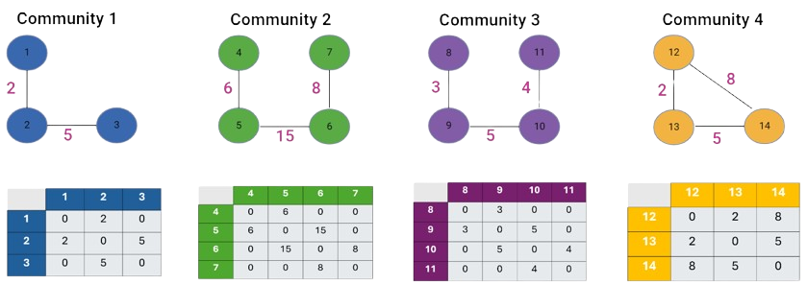
ADJACENCY MATRIX - TOY EXAMPLE

Slide 6
ADJACENCY MATRIX - TOY EXAMPLE

Slide 7
ADJACENCY MATRIX - TOY EXAMPLE
Communities Pair | similarity Score
1 + 2 | 0.90
1 + 3 | 0.94
1 + 4 | 0.56
2 + 3 | 0.93
2 + 4 | 0.50
3 + 4 | 0.53

Slide 8
ADJACENCY MATRIX - TOY EXAMPLE
Communities Pair | similarity Score
1 + 2 | 0.90
1 + 3 | 0.94
1 + 4 | 0.56
2 + 3 | 0.93
2 + 4 | 0.50
3 + 4 | 0.53

Slide 9

THANK
YOU FOR LISTENING!

